Slide 1
JUDGE TRAINING
The Judge’s Job is to:
Choose the Best
Encourage the Rest

Slide 2
Why Do A Science Project?
Valuable real life lesson:
Make a plan & budget time (learn project skills)
Background Research
Gather Materials
Execute Plan
Evaluate Results (interpretation of data)
Present the Results
Academic “cross training” using multiple disciplines (project categories)

Slide 3
What Does A Science Display Look Like?
Display
Data Logbook/Journal
Abstract, Problem/Hypothesis, Procedure, Results, Conclusion
SRC Forms: form 1C & form 7 if needed must be vertically displayed at exhibit; the rest of the forms must be available at the exhibit for inspection. All projects have already been checked for compliance with international rules.

Slide 4
Sample Exhibit/Display

Slide 5
Sample Exhibit/Display

Slide 6
Sample Exhibit/Display

Slide 7
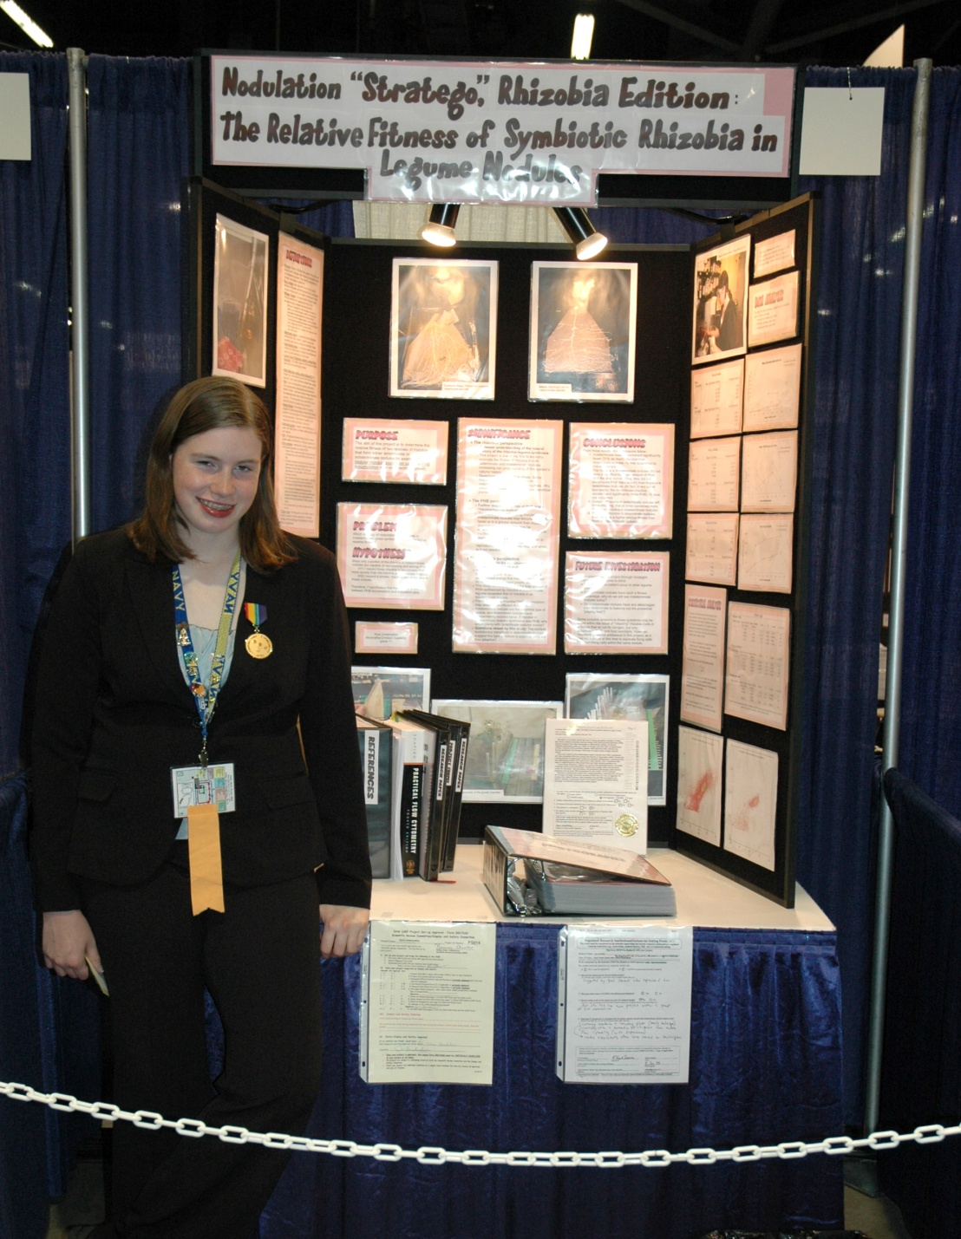
Sample Exhibit/Display

Slide 8
Sample Exhibit/Display

Slide 9
Sample Exhibit/Display

Slide 10
Sample Exhibit/Display

Slide 11
Sample Exhibit/Display

Slide 12
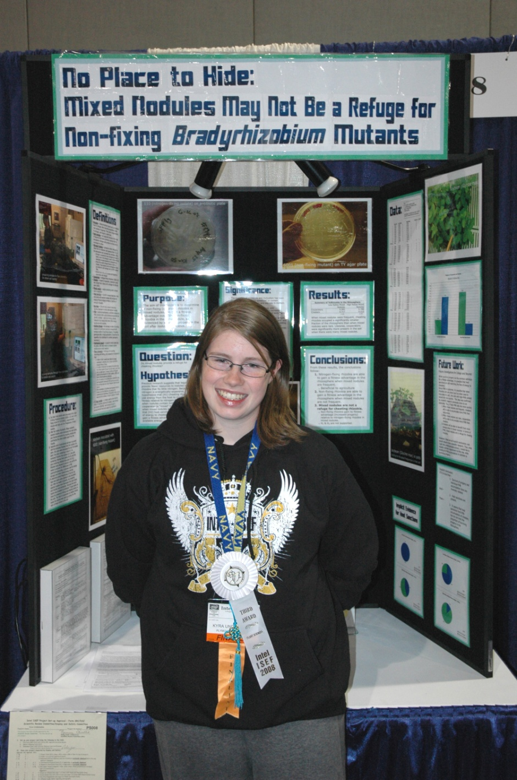
Sample Exhibit/Display

Slide 13
How to Start
Pull out your score sheet for the project. We recommend you walk by and look at several of the projects in the area to get some comparison before you start. It should be already labeled with your judge number & the project number, title & student(s) name. DO NOT tell students their scores nor give them score sheets. Give the students verbal feedback/comments during your time interviewing them. Remember to encourage them, give them something(s) they did well and something they can improve, and perhaps give them more ideas for the future. Turn in your score sheets to the Judging Area for all projects, and turn in the special awards judging sheets to the Special Awards Judging Area.
Ask the student: “Tell me about your project.” or “How did you come up with this idea?” Be sure to LISTEN!
Let the student tell their story and ask questions. Don’t continue to press a question if the student does not know.

Slide 14
Two Types of Judges
We have two types of judges on the show floor during judging:
Ribbon judges: You are the judges that score the projects. You are the heart & soul of this competition! Students will be awarded a green, red, or blue ribbon based on their scores. The projects selected to compete at state will receive a purple ribbon in addition to their blue ribbon. Some other awards are also based on score.
Special Awards judges: You are the judges representing organizations who have provided awards with special criteria. You choose those receiving the “goodies” such as cash, trophies, medals, certificates, shirts, further competitions, scholarships, or other opportunities. Be sure to select projects that match your criteria when awarding this kind of award.

Slide 15
Judging the Board / Project for those scoring projects
Interview each project for 8-12 minutes
Exhibit display board quality should not impact score for science knowledge and experimental design
Beware of the slick salesperson
Focus on the science
The presenter can do amazing things – trust what they say to you, but ask questions!

Slide 16
Judging Score sheet
Optional: make notes if needed on the score sheet (things done well, errors in the science or analysis, missing pieces) – students do not get this sheet! Notes are for your benefit only. Your job is to choose the best project in ranking order by the rubric’s standards!
Data entry people WILL NOT add or re-add your scores. If your scores do not add correctly, the student will receive the bottom line score you wrote, NOT the sum of the parts. If you changed your bottom line total without changing the parts, draw a line through the parts and circle the correct total so there is no confusion which is correct.
Use the grading rubric to value each part correctly.

Slide 17
The Roles Of All Judges You are a…
Role Model
Evaluator
Facilitator
Motivator
Counselor
Fellow Scientist, interested in the student’s work

Slide 18
Judge Experience
Be genuine
Let the student show their stuff
Encourage conversation – Ask questions
Avoid value judgments
Complement the student on things done well!
Give one opportunity for improvement
End meeting on a positive note
Smile

Slide 19
Judge Behavior
Put students at ease. Look them in the eye – You could offer to shake their hand – take an interest in their project, their display boards, their lab notebook, and their research paper if present.
Show you are interested
Listen actively
Ask students enough questions to satisfy yourself that they understood & did the project
(team projects must show that all members contributed expertise to the project!)
When you have reached the student’s knowledge limit, STOP asking questions
Remember when you were 12-16 years old?

Slide 20
Sample Questions
Where did you get the idea for your project?
What is the purpose of your study?
What background research did you do? What have others done before?
Why is this project important to you? (OR Why are you interested in this?) …

Slide 21
More Sample Questions
Explain your procedure. (What did you do? Why did you do that? How does that work?)
What is your control? Variables?
What instruments did you use for measurements? …

Slide 22
Sample Questions
On what did you base your conclusions?
Did you repeat your tests? How many times? Any statistics? Why did you choose that method of analysis or statistic?
What are your sources of error?
How did you calculate (that) or how did you make that graph? …

Slide 23
Sample Questions
Did your results support your hypothesis? (Why or why not?)
Do your results indicate further study is needed?
Are there other approaches you might have taken to your research?
Of what value is your project to society? (Practical Application) …

Slide 24
Sample Questions
What problems arose during your investigation?
How did you overcome problems?
What did you come up with that was new, unique, or creative in this project? …

Slide 25
Sample Questions
How much time did your study take?
What would you do differently?
What would you do next (Future Work)?
What did you enjoy most about your project?

Slide 26
Also Consider…
Knowledge base developed
Experimental or Engineering Design – (follow Scientific Method OR show new theory or design)
Uniqueness/Creativity
Hard Work
Enthusiasm
NOTE: It is completely acceptable to DISPROVE your hypothesis!

Slide 27
Judge Tips
Student understanding & scientific thought may be more important than actual results.
Don’t tally scores in front of students.
Don’t verbally criticize or degrade projects. (A LOT OF EARS ARE LISTENING!)
How much of the project is the student’s versus the mentor or parent? (Believe the student. Consider asking them to explain how they came up with the idea(s) if you think they were “lab rats” with too much outside help.)

Slide 28
More Judging Tips
If stuck on project, ask for help
Don’t judge a project if you have a conflict of interest (related or friends)
Note that for team projects, all should contribute – and show what each team member did for the project (teams may be 2 or 3 students)- Encourage all team members to speak if they are present.
Please take just 2 minutes to give the student some feedback on their project and presentation. Be constructive and encouraging. DO NOT GIVE ANY papers or verbal scores to the students!
Help yourself to dinner

Slide 29
Look over all the projects in your group to get a feel for what to expect.
Keep on schedule with your judging. Budget your time (10 minutes for many projects, and 15 min max judging for top high school projects & 5 min to write scores & find next project). Please stay on schedule. Get your numeric scores in as soon as possible for data entry!
Make sure the best projects receive the best score (according to the criteria given).
Most importantly: Have FUN!

Slide 30
How is the project ranking determined using the scores?
Each judge needs to score at least 6 projects (8 projects preferred) within a division: high school (grade 9-12) or middle school (grade 6-8). We calculate average score for the project & rank by average score.
We calculate average Z-score for the project (Z-score compares how you ranked the project in the group of projects you judged – see next slide for more.)
We calculate a normalized blend of average and Z-score. WHY??? …

Slide 31
Scoring Used
Average alone does not tell the entire story because some judges score higher & some lower than others.
Z-score alone at regional does not tell the entire story either because the method ASSUMES that you are judging a normal distribution of projects. If you happen to get all top of the line projects… these score poorly (near your average) with Z-score. That’s not fair, either!
So for TCRSF, we rank by average, rank by Z-score, then create a blend score which is part average score & part normalized Z-score. Then we analyze for outliers and look at all 3 rankings to be sure that we have indeed chosen the best based on your scores. If results are not clear, we look at how a specific project ranked within each judge’s group they judged and make a determination.

Slide 32
Z-Score Calculation
m = Σx / n calculate mean (m) of judge’s set of scores: mean (m) = sum of scores (Σx)/number of projects scored (n)
NOTE: We separate middle school & high school score calculations, so you must score at least 6 (8 is the preferred minimum # of scores) in each division if you judge in both divisions!
S = √ (n(Σx²) – (Σx)²) / (n(n-1)) calculate the standard deviation (s) of judge’s set of scores (Σx = sum of scores; n = number of projects scored)
Z = (x – μ) / s calculate the Z-score (Z) for each project scored by the judge (x = project score; m = mean of judge’s set of scores; s = standard deviation of judge’s set of scores)
All “Z-scores” from judges for each project will be averaged; most will rank between –1.5 and +1.5, with 0 representing the average/mean score.

Slide 33
SRC Paperwork
All SRC paperwork has already been checked by the TCRSF Scientific Review Committee. You do not need to check the forms. The students do not have to display all their forms, but must have them available for you to see them if you desire. Form 1C & 7 must be displayed vertically if required for the project.
All projects must have a Form 1, Form 1A, Complete Research Plan (Problem/Question, Hypothesis, Detailed Procedure, & Bibliography of a minimum of 5 references), Form 1B, and a printed abstract. The abstract does not have to be on the official ISEF form. Additional forms are required for projects including humans, vertebrates, bacteria, tissues, body fluids, hazardous devices or materials, projects done in an outside lab, or continuation projects. Judges do not need to check these, but may look at them if the judge desires.

Slide 34
Remember…
Your job is to:
Choose the Best
Encourage the Rest
Thank you for encouraging these students in science/engineering!

